Slide 1
Portfolio selection with a drawdown constraint
Gordon J. Alexander Alexandre Baptiste
Presented By:-
Nicholas Handelman
Shreyas Shanbhag

Slide 2
Abbreviations used
ER - Expected Return
SD - Standard Deviation
MV - Mean-Variance
MD - Maximum Drawdown
RF - Risk Free
TEV - Tracking Error Volatility
MTEV - Mean-TEV

Slide 3
Introduction and Motivation
A previous paper (Chekhlov, Uryasev) discussed several Mean-Drawdown optimizations
This paper implements and discusses the implications of adding an MD constraint to three optimizations: MV no RF, MV RF and MTEV no RF
The main contribution of this paper is the characterization of optimal portfolios in the presence of an MD constraint. It does not develop a Mean-Drawdown optimization.
The characterization includes the development of an analytical solutions for constrained optimal portfolios *
Another motivation includes pointing out a possible issue with Merrill Lynch’s failed management of Unilever’s pension fund

Slide 4
Project Overview
Retrieve and prepare data for analysis
Calculate basic statistics
Calculate unconstrained MV efficient boundary without RF security
Calculate 1) MD constrained MV efficient boundary without RF security and 2) associated Fund Separation
Calculate unconstrained MV efficient boundary with RF security
Calculate 1) MD constrained MV efficient boundary with RF security and 2) associated Fund Separation
Calculate unconstrained MTEV efficient boundary without RF security
Calculate 1) MD constrained MTEV efficient boundary without RF security and 2) associated Fund Separation
Discuss results for 3-8. This is done within each section and in the conclusion.
Discuss issues and concerns

Slide 5
Data
We used the same data and time period as described in the paper.
10 MSCI Country Indexes: Australia, Canada, France, Germany, Italy, Japan, Netherlands, Switzerland, UK, USA
https://www.msci.com/end-of-day-data-search
Each index is composed of large and mid cap stocks in each country.
Years: 1970-2004.
We calculated the yearly returns for the data. No other adjustments made.
The data we retrieved has changed, this is shown by different means, standard deviations and correlations.

Slide 6
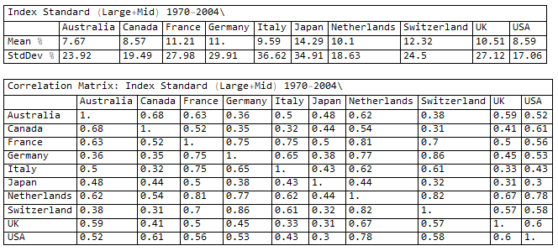
Basic Statistics

Slide 7
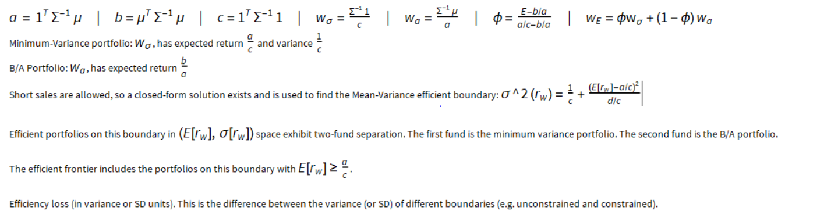
Unconstrained MV Efficient Boundary, no RF Security

Slide 8
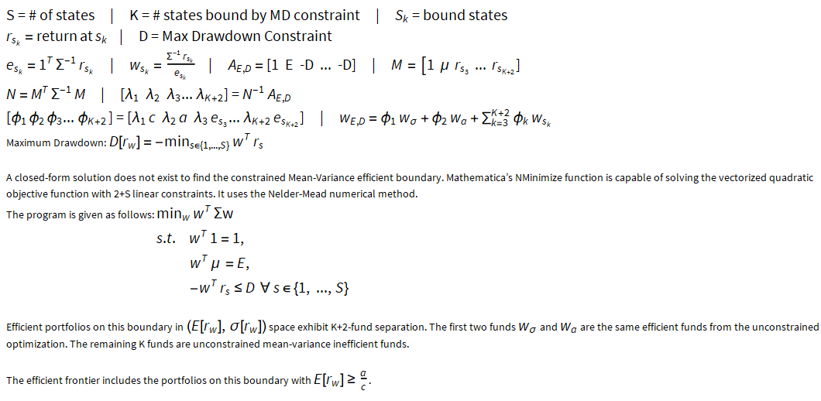
MD constrained MV Efficient Boundary, no RF Security

Slide 9
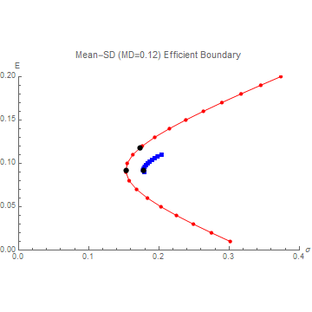

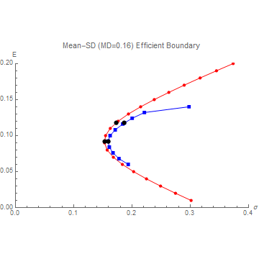
Graphs of MV Efficient Boundaries, no RF Security

Slide 10
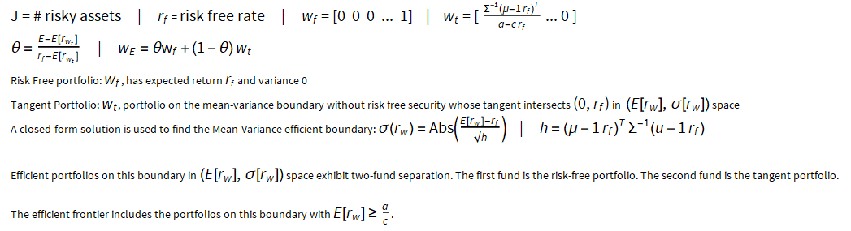
Unconstrained MV Efficient Boundary, RF Security

Slide 11
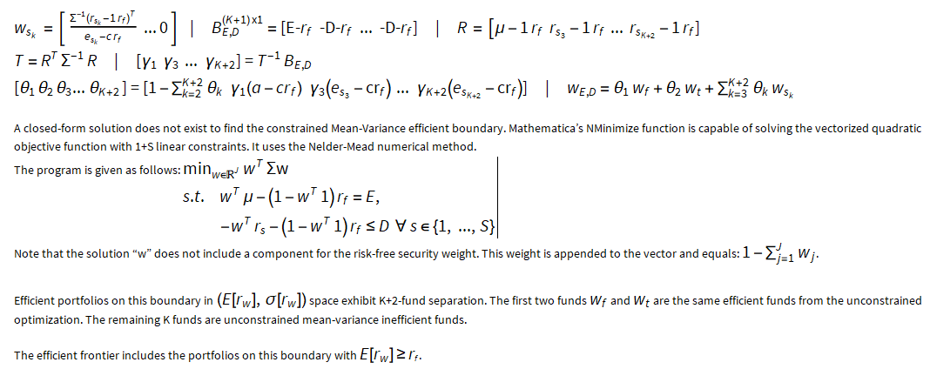
MD constrained MV Efficient Boundary, RF Security

Slide 12
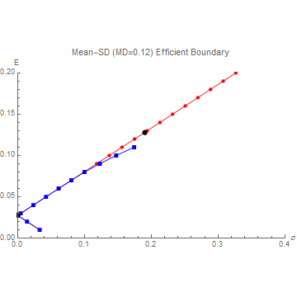
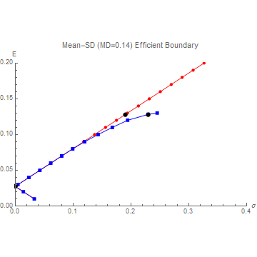
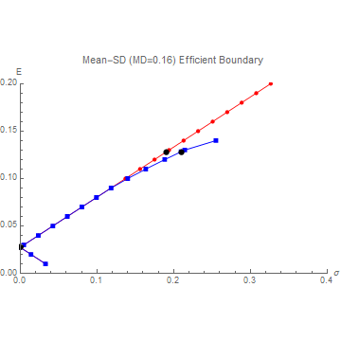
Graphs of MV Efficient Boundaries, RF Security

Slide 13
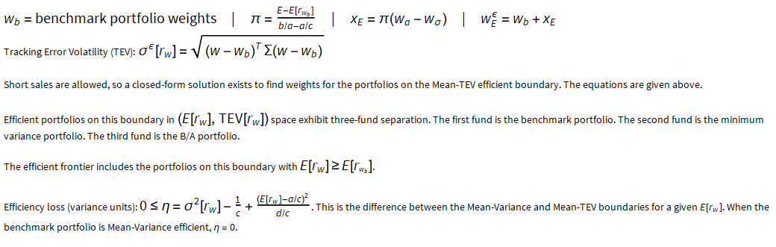
Unconstrained MTEV Efficient Boundary, no RF Security

Slide 14
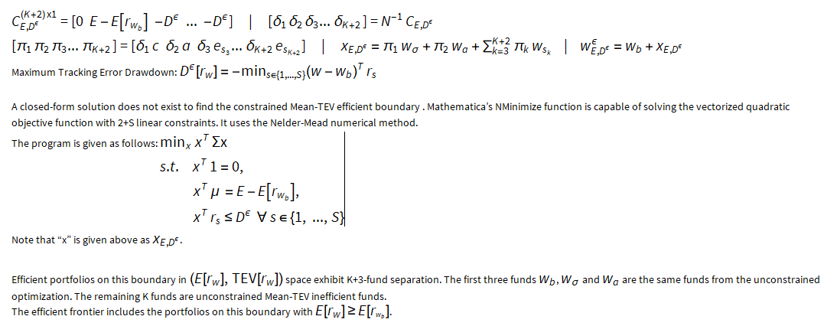
MD constrained MTEV Efficient Boundary, no RF Security

Slide 15
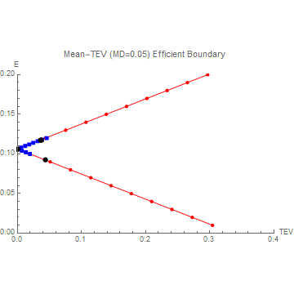

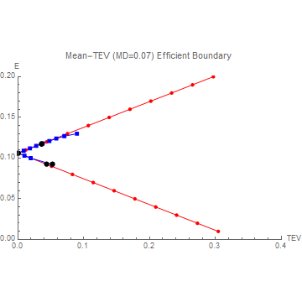
Graphs of MTEV Efficient Boundaries, no RF Security
In (M, TEV) Space

Slide 16
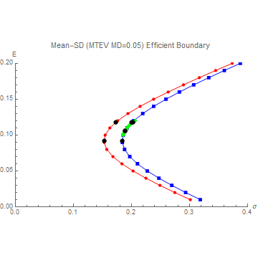

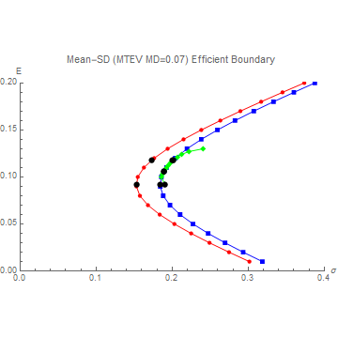
Graphs of MV, MTEV Efficient Boundaries, no RF Security
In (M, SD) Space

Slide 17
Efficient Boundary Conclusions
Addition of a RF security changes the characteristics of the efficient boundary
Addition of a non-trivial MD constraint to the MV no RF optimization results in a new efficient boundary that is always unconstrained inefficient. This is not true in the MV RF and MTEV optimizations. Certain optimal portfolios are unaffected by the MD constraint
MV no RF optimization is MV RF inefficient except for the tangent portfolio
MTEV optimized portfolios are MV efficient if the benchmark portfolio is MV efficient. The paper notes that in practice, the benchmark is MV inefficient. So, in practice, MTEV optimization will be MV inefficient

Slide 18
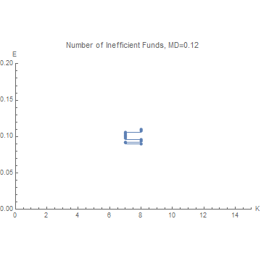
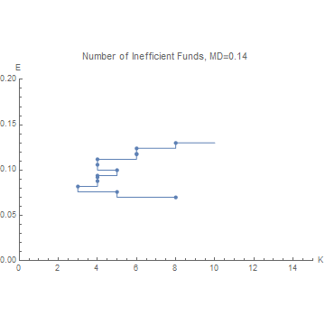
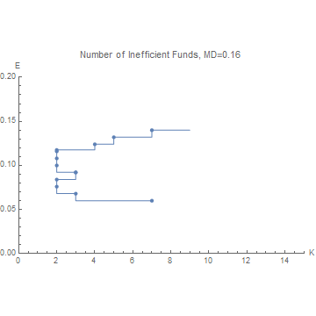
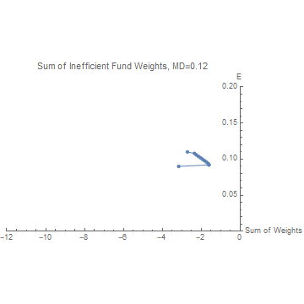
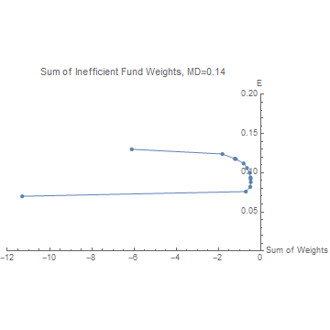
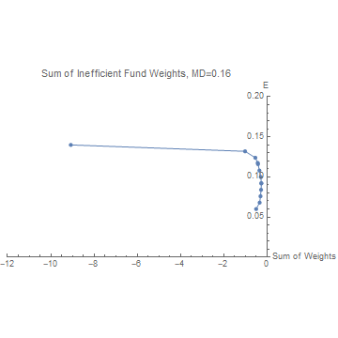
Graphs of Fund Separation, MV no RF
ER vs. Number of Inefficient Funds
ER vs. Sum of Inefficient Fund Weights

Slide 19
Analysis of Fund Separation, MV no RF
K: number of bound states
Fund Separation: e.g. One and Two Fund Theorem, efficient portfolios are linear combination of other efficient (or inefficient) portfolios
Portfolios on the MD constrained boundary have K+2 fund separation
Min Variance portfolio, B/A portfolio, K MV inefficient funds
As MD constraint increases, the range of feasible ERs increases
Efficient portfolios at edge of feasibility have higher fund separation
As the MD constraint increases, fund separation decreases
Sum of inefficient funds is parabolic and appears to be minimized near the minimum variance portfolio
Fewer inefficient funds does not guarantee smaller sum of inefficient fund weights
For this data, there are never more than 8 inefficient funds, though their weights can differ greatly

Slide 20
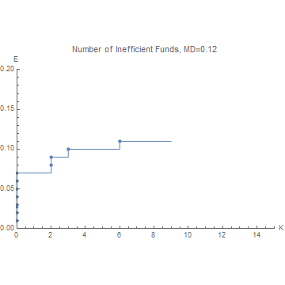
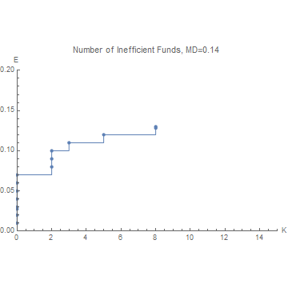
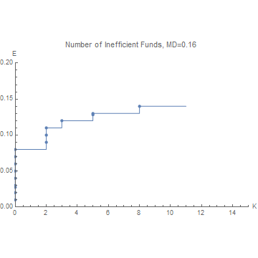
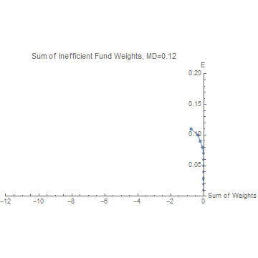
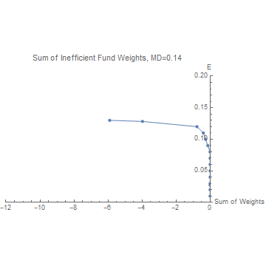
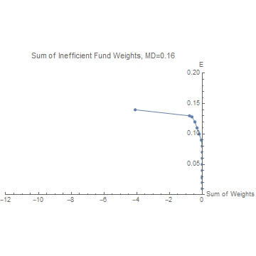
Graphs of Fund Separation, MV RF
ER vs. Number of Inefficient Funds
ER vs. Sum of Inefficient Fund Weights

Slide 21
Analysis of Fund Separation, MV RF
Portfolios on the MD constrained boundary have K+2 fund separation
Risk Free portfolio, Tangent portfolio, K MV RF inefficient funds
As MD constraint increases, the range of feasible ERs increases. Only clear here for higher ERs since the risk free rate is low
Efficient portfolios at edge of feasibility have higher fund separation
As the MD constraint increases, fund separation decreases
Lower expected returns characterized completely by risk free and tangent portfolios
It appears that as the number of inefficient funds increases, the sum of their weights increases also
For this data, there are never more than 8 inefficient funds, though their weights can differ greatly

Slide 22
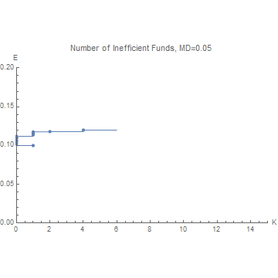
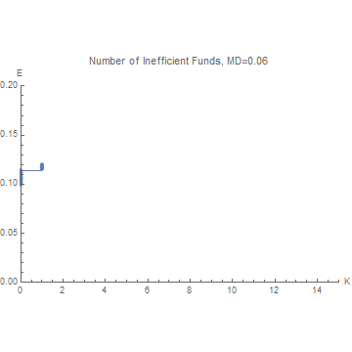
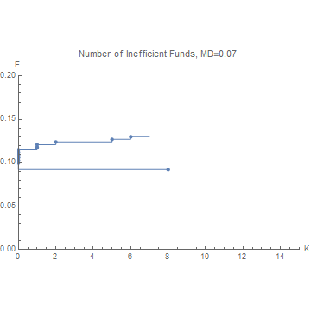
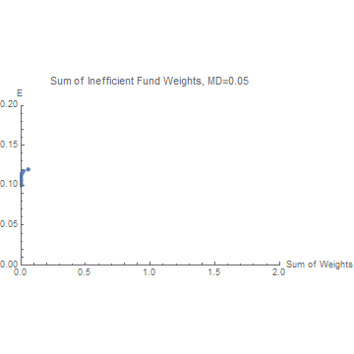
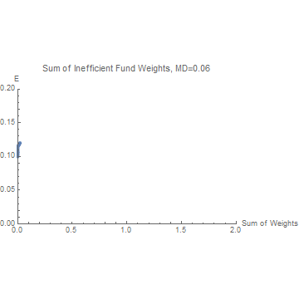
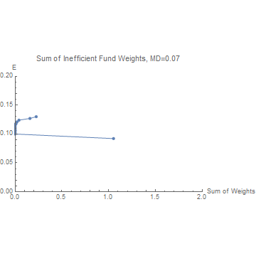
Graphs of Fund Separation, MTEV no RF
ER vs. Number of Inefficient Funds
ER vs. Sum of Inefficient Fund Weights

Slide 23
Analysis of Fund Separation, MTEV no RF
Portfolios on the MD constrained boundary have K+3 fund separation
Benchmark portfolio (MTEV efficient), Min Variance portfolio and B/A portfolio (MV efficient), K MTEV inefficient funds
As MD constraint increases, the range of feasible ERs increases
Efficient portfolios at edge of feasibility have higher fund separation
As the MD constraint increases, fund separation decreases
It appears that as the number of inefficient funds increases, the sum of their weights increases also
For this data, there are never more than 8 inefficient funds, though their weights can differ greatly
Increasing the MD constraint from 0.05 to 0.06 only marginally (<0.01) increases the feasible ERs but does decrease the fund separation in that range

Slide 24
Fund Separation Conclusions
Constrained MV optimization, with or without a RF security, exhibits K+2 fund separation, where K is the number of bound states.
The number of inefficient funds is locally constant and typically increased as the ER moved towards the edges of the feasible range. The sum of the weights of the inefficient funds always increased as the ER moved towards the edges of feasible range.
The number of inefficient funds is never more than 8. This will depend on the data.

Slide 25
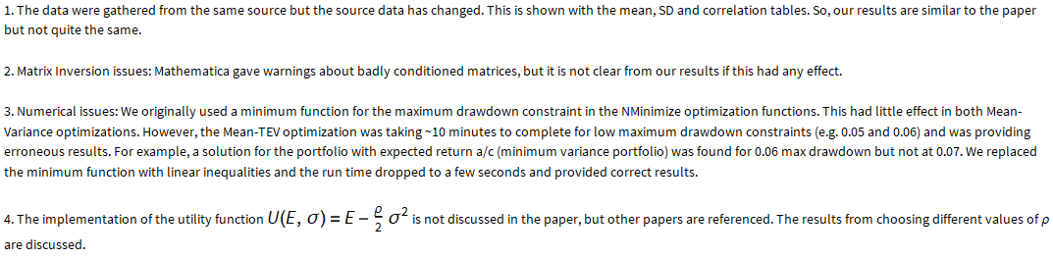
Issues and Other Concerns

